Slide 1
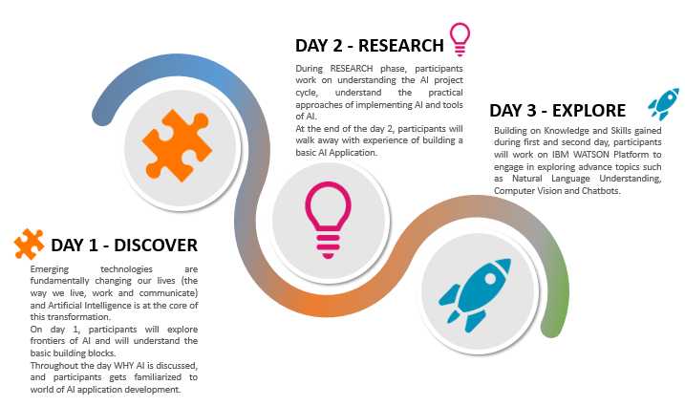
AI Teacher Training

